Slide 1
OpenSky API Data Pipeline
- Kumar Naman

Slide 2
Agenda
OpenSky State API Overview
Scope of Work
Tools and Technology Used
Data Flow Diagram
Code Walkthrough
Data Pipeline Demonstration
Data Insights

Slide 3
OpenSky States API Overview
The OpenSky network provides live API to access real world air traffic control data to the public.
This API helps you to retrieve state of an aircraft at certain point of time mainly position, velocity, heading etc.

Slide 4
Scope of Work
Design and Develop data engineering solution to access the data from API and process it and make it available for analysis.
Create a data pipeline which should do following tasks –
Connect to API
Fetch Data
Data Cleaning
Audit every pipeline run
Error Handling
Prepare Analytics ready data
Get insights from data
Data mart will be built consisting of facts and dimension which allows the business users to slice and dice the data and built models on top of them.
Creation of Dashboards

Slide 5
Tools & Technologies used
Python
Programming Language
Used to Orchestrate the data pipeline flow
Snowflake
Cloud Database Solution
Store data collected from OpenSky API
Power BI
Visualization

Slide 6
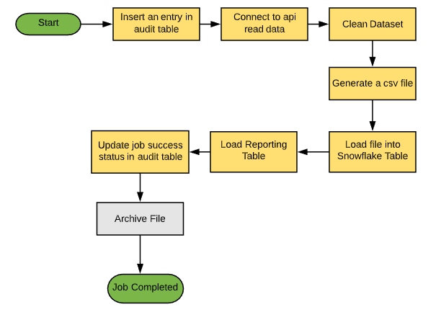
Data Flow Diagram

Slide 7
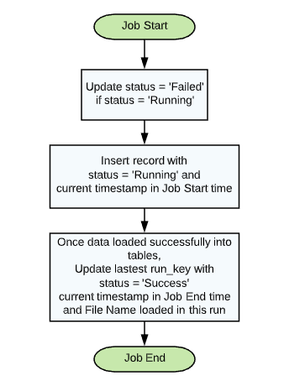
Pipeline Auditing

Slide 8
Code Walkthrough
How source data looks like
Python
Snowflake
Final Data

Slide 9
Data Pipeline Demonstration

Slide 10
Insights from Data
Total number of flights in air all over the world during 2AM IST to 3 AM IST
Top 5 countries having highest air traffic
Top 5 flights moving with highest velocity
Count of flights on ground vs count of flights in air at particular time
Detailed Report where Difference between geo_altitude and baro_altitude readings is more than 1000 meters

Slide 11
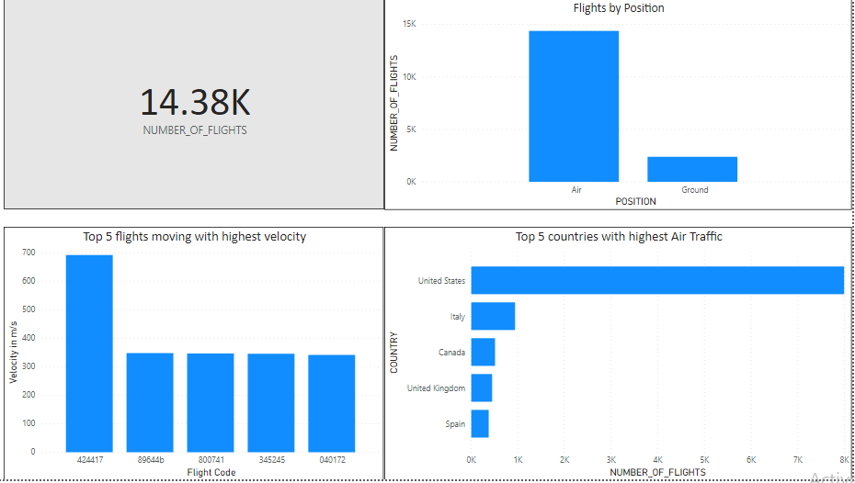
Insights from Data

Slide 12
Thank You !

